Slide 1
WELCOME

Slide 2
ORGANIZATION VISITING:
SECURE LINK SERVICES BD LTD.
Course Name: Business Studies for Engineers
Course Code: BUS 405
Supervised by-
Mr. Md. Iftekharul Amin
Assistant Professor
Institute of Business Administration
University Of Dhaka

Slide 3
Presented By – Group 4
Shayakh Shihab Uddin (BSSE-0813)
Mohammad Ibrahim (BSSE-0814)
Shuvradeb Saha (BSSE-0815)

Slide 4
Presentation Outline
Aim of the project
About the organization
Organogram
Recruitment system
Socialization
Sports and Rituals
Social Responsibility
Office Description
Photos

Slide 5
Aim of the project
To study the organizational culture
Know about the structure of an organization
Get an idea about the relationship between manager and employee
Know about environment of an organization

Slide 6
About the organization
International provider of digital innovation, software engineering and management consulting services.
Headquarter in Switzerland.
4 branch. In Bangladesh, Switzerland, UAE, Bhutan.
Started in – 10 January 2005.

Slide 7
Organogram
CEO
COO
CTO
OSG
HRM
SEM
ADM
TM
PDM
TL
TL
...
Team Mem
Team Mem
…

Slide 8
Recruitment System
Senior Employee:
- Advertisement in newspaper.
- Daylong problem solving exam.
- face to face interview.
Fresher Employee:
- Day long problem solving exam.

Slide 9
Socialization
Arranging orientation program for new employee.
New employee has to give a joining party.
New employee has to work under a senior.

Slide 10
Sports & Rituals
Abroad tour every year.
Annual dinner party with whole family.
Participate inter software company football and cricket.

Slide 11
Social Responsibility
Jago foundation, Bidyanondo foundation.
Provide computer and financial help among poor students.

Slide 12
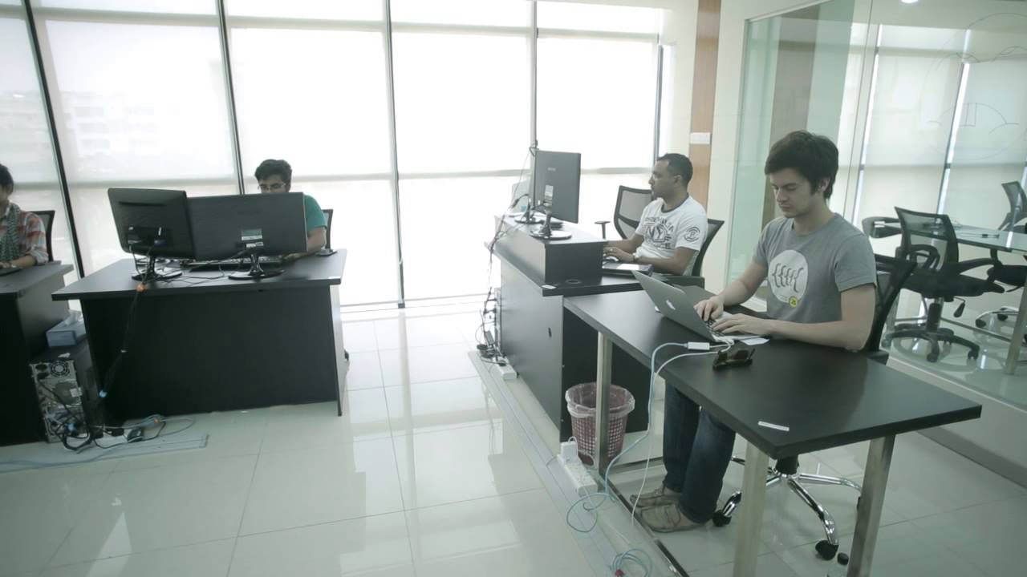
Office Description
Secure Link Services BD Ltd.
Midas, House 5, Road 16
Dhanmondi
Dhaka, 1209, Bangladesh

Slide 13
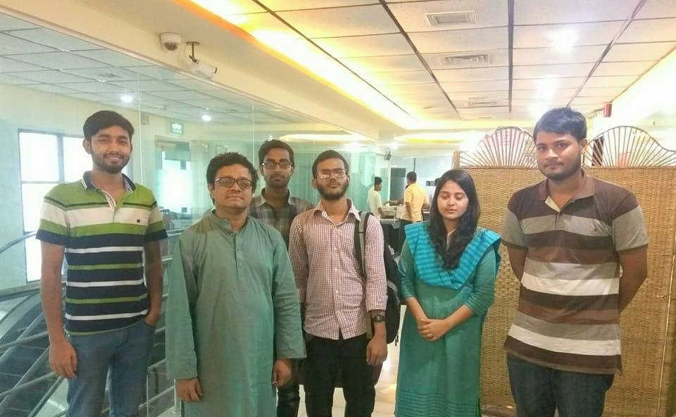
Photos
With Shah A. Newaj Chief Technology Officer of SELISE.

Slide 14
Thank You

